Slide 1
Economic analysis of Solar PV
M.Karuppasamypandiyan

Slide 2
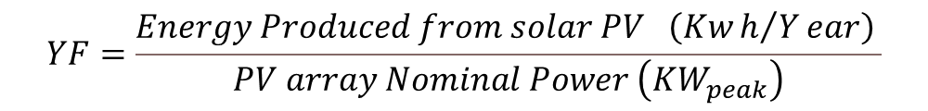
Technical Metrics
Yield Factor (YF):
Yield factor is the total energy produced by a PV system over one month or year.
Because of the various module efficiencies and array designs, the yield factor is used to measure the system’s productivity.
Yield factor is measured in kWh/kWp, by dividing the energy yield by the PV array’s nominal power
$$YF=\frac{Energy Produced from solar PV \left(Kwh/Year\right) }{PV array Nominal Power \left({KW}_{peak}\right)}$$

Slide 3

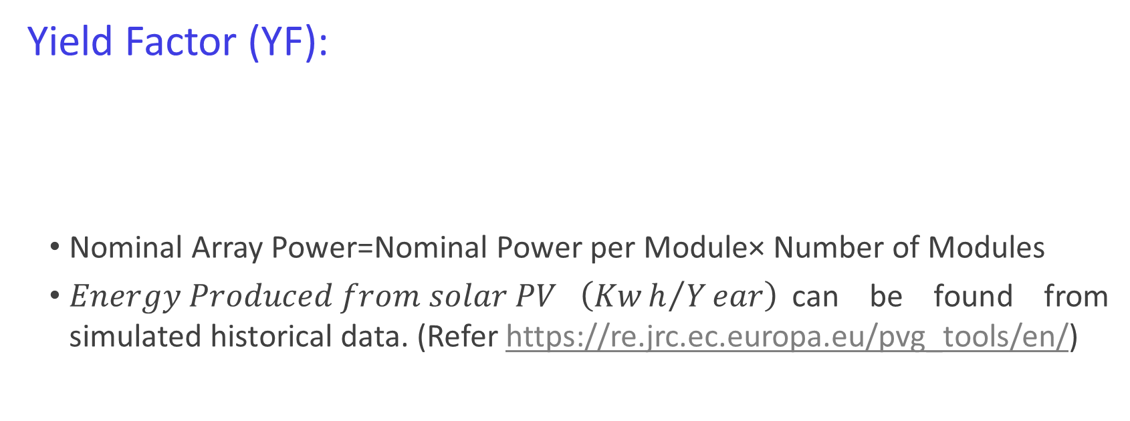
Technical Metrics
Yield Factor (YF):
Nominal Array Power=Nominal Power per Module× Number of Modules
$Energy Produced from solar PV \left(Kwh/Year\right)$can be found from simulated historical data. (Refer https://re.jrc.ec.europa.eu/pvg_tools/en/)
$$YF=\frac{Energy Produced from solar PV \left(Kwh/Year\right) }{PV array Nominal Power \left({KW}_{peak}\right)}$$

Slide 4
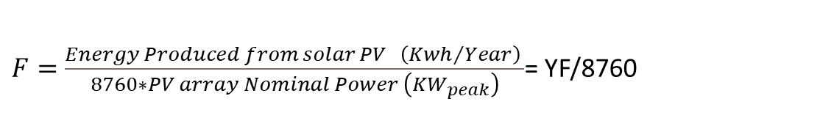
Technical Metrics
Capacity Factor:
Capacity Factor (CF) Capacity factor is the ratio of the actual annual energy yield of a PV array to the energy it would produce when operating at full capacity over one year.
Capacity factor estimates the percentage of the PV array that is usable, and the most ideal CF is 50% because of the daily sun availability.
$F=\frac{Energy Produced from solar PV \left(Kwh/Year\right) }{8760∗PV array Nominal Power \left({KW}_{peak}\right)}$= YF/8760

Slide 5

Technical Metrics
Performance Ratio
Performance ratio is a metric that defines the quality of a PV system regardless of its location and size.
where GSTC is amount of irradiance at STC and Gt is the accumulative irradiance on the PV array plane within a certain period (annual, monthly, or daily).
Gt= Beam (Direct) Irradiance+ Diffuse Irradiance+ Reflected Irradiance

Slide 6

Economic Metrics
Levelized Cost of Energy (LCOE)
Levelized cost of energy (LCOE) estimates the price of per unit energy ($/kWh) over the project’s lifetime.
LCOE $=\frac{LCC}{Energy Produced from solar PV from the life time}$
The lifecycle cost includes the initial capital cost, operation, and maintenance cost, as well as the replacement cost minus the salvage value, which is the project value at the system’s end of life.

Slide 7
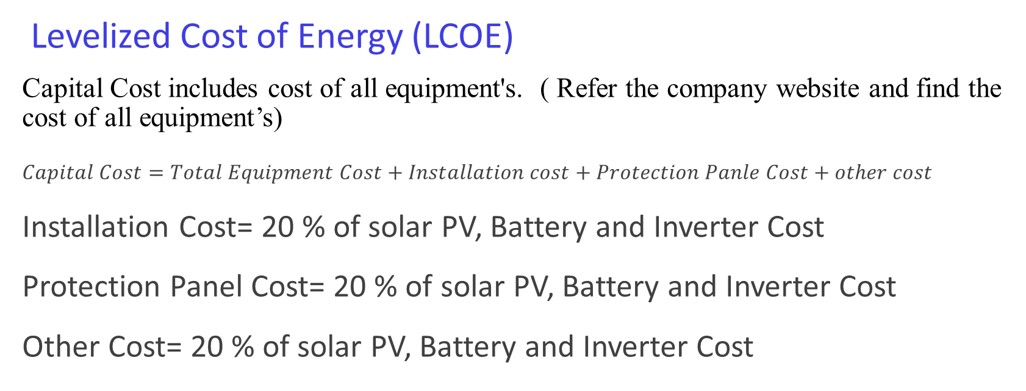
Economic Analysis
Levelized Cost of Energy (LCOE)
Capital Cost includes cost of all equipment's. ( Refer the company website and find the cost of all equipment’s)
$Capital Cost=Total Equipment Cost+Installation cost+Protection Panle Cost+other cost$
Installation Cost= 20 % of solar PV, Battery and Inverter Cost
Protection Panel Cost= 20 % of solar PV, Battery and Inverter Cost
Other Cost= 20 % of solar PV, Battery and Inverter Cost

Slide 8
Economic Analysis
Levelized Cost of Energy (LCOE)
Operation and Maintenance cost can be considered as 0.5% of capital cost.
Assume 0.5 % in Operation and Maintenance for first 10 Years and 1.5 % increase in 11-15 Years and 2.5 % 16-20 Years and 4% in 21-25 Years.
Replacement Cost= Inverter Replacement cost (after 15 Years) + Battery Replacement Cost (After 15 Years).
Salvage cost= Assume 15% of systems Capital cost
Assume life time as 25 Years. Annual Production (Year n)=Initial Production×(1−Degradation Rate)^n
The typical degradation rate of modern solar PV panels is between 0.5% and 1% per year, depending on the module quality, manufacturer, and environmental conditions. After 25 years, a well-maintained system typically operates at 75–85% of its initial capacity.
High-quality panels: Degrade at ~0.5% per year.
Standard panels: Degrade at ~0.8–1% per year. (Assume We use Standard Panel having 1% Degradation Rate)

Slide 9

Economic Analysis
Net Present Value (NPV)
The net present value refers to the difference between today’s value of cash inflow and the cash outflow over a project or business’s lifetime.
where N is the number of years of the economic analysis, t is the year variable in each summation, d refers to the discount rate, Revenue is the PV system revenue in year t, and Cost represents the system cost in year t.
Assume Discount Rate as 8%.
Revenue in a year= Energy Unit Produced in a particular year *Electricity Tariff per unit
(In Tamil Nadu, for the Private Educational Institute, the Electricity Tariff is Rs. 9.10 per unit)

Slide 10
Economic Analysis
Net Present Value (NPV)
Positive NPV (NPV>):The project generates more cash inflows than outflows in present value terms, indicating it is profitable.
Accepting the project will increase the value of the investment.
Negative NPV (NPV<0):The project’s cash inflows are insufficient to cover the initial investment and other costs in present value terms.
Indicates the project will result in a net loss and should be rejected.
Zero NPV (NPV=0):The project’s inflows and outflows are equal in present value terms.
The project neither gains nor loses value but meets the minimum required rate of return (discount rate).

Slide 11
Economic Analysis
Payback Period:
Payback period refers to the time needed for an investment to o set the amount invested in terms of profits or net cash flow.
$$Simple Payback Period=\frac{Total Capital Cost}{Annual Solar PV Energy Produced \left(in Units\right)∗Tariff}$$

